Slide 1
Mountain Pine Beetle Attack Severity from 1999-2010
100 Mile House TSA
Kamloops TSA
Quesnel TSA
Williams Lake TSA
Cascades FD
Ft. St. James FD
Prince George FD
Vanderhoof FD

Slide 2
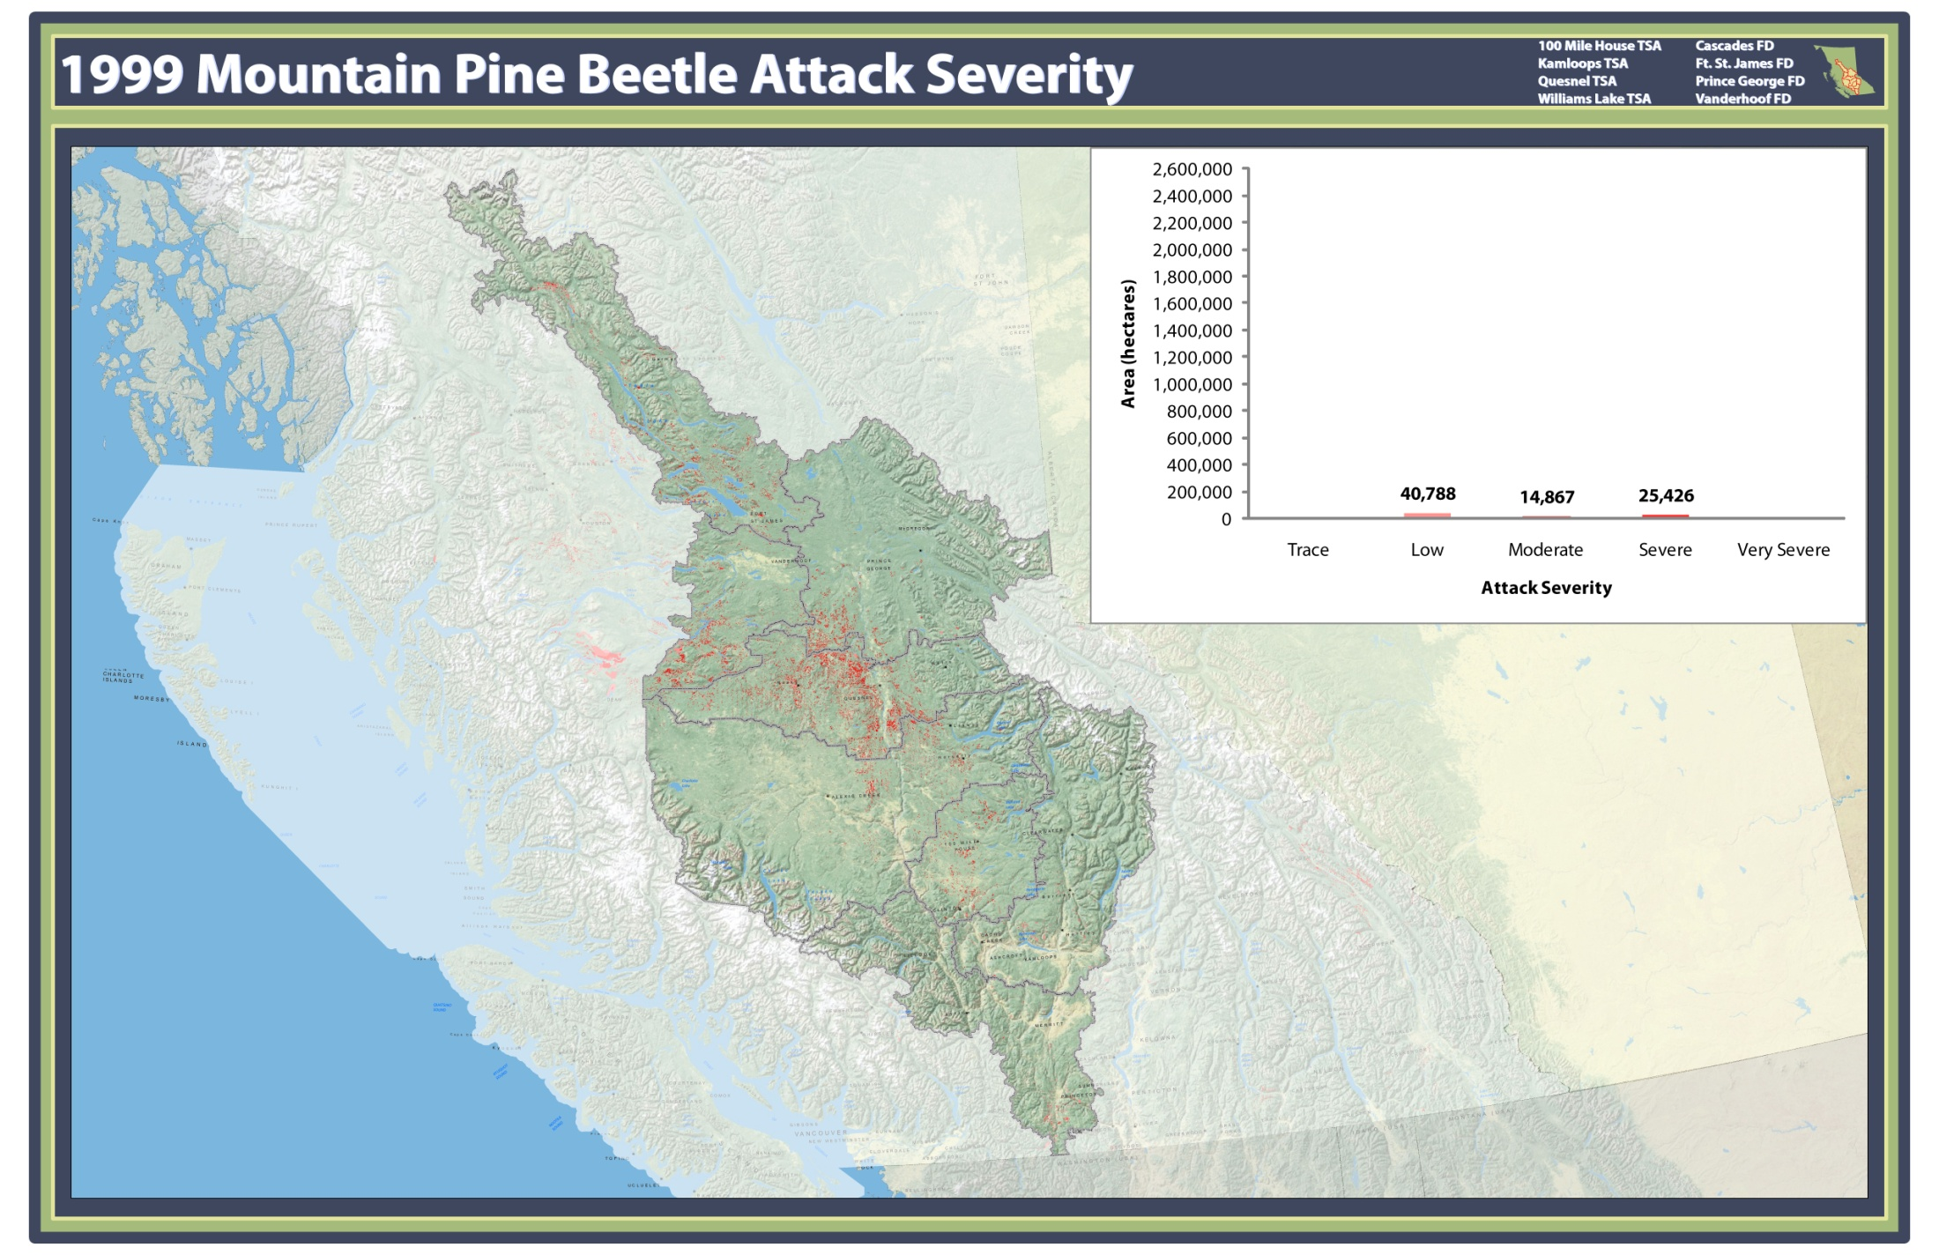

Slide 3
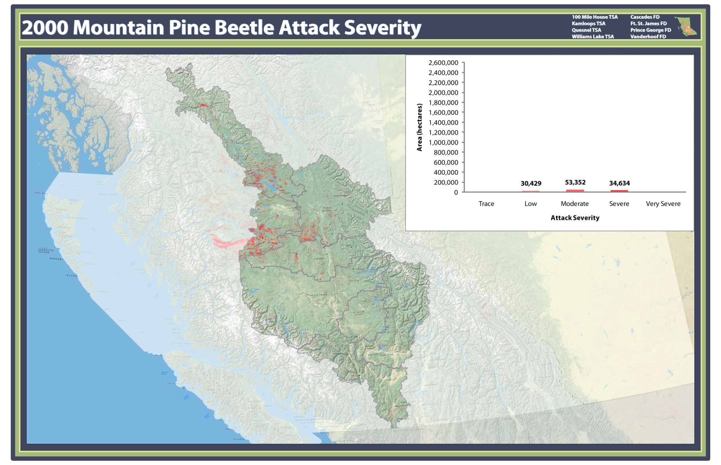

Slide 4


Slide 5
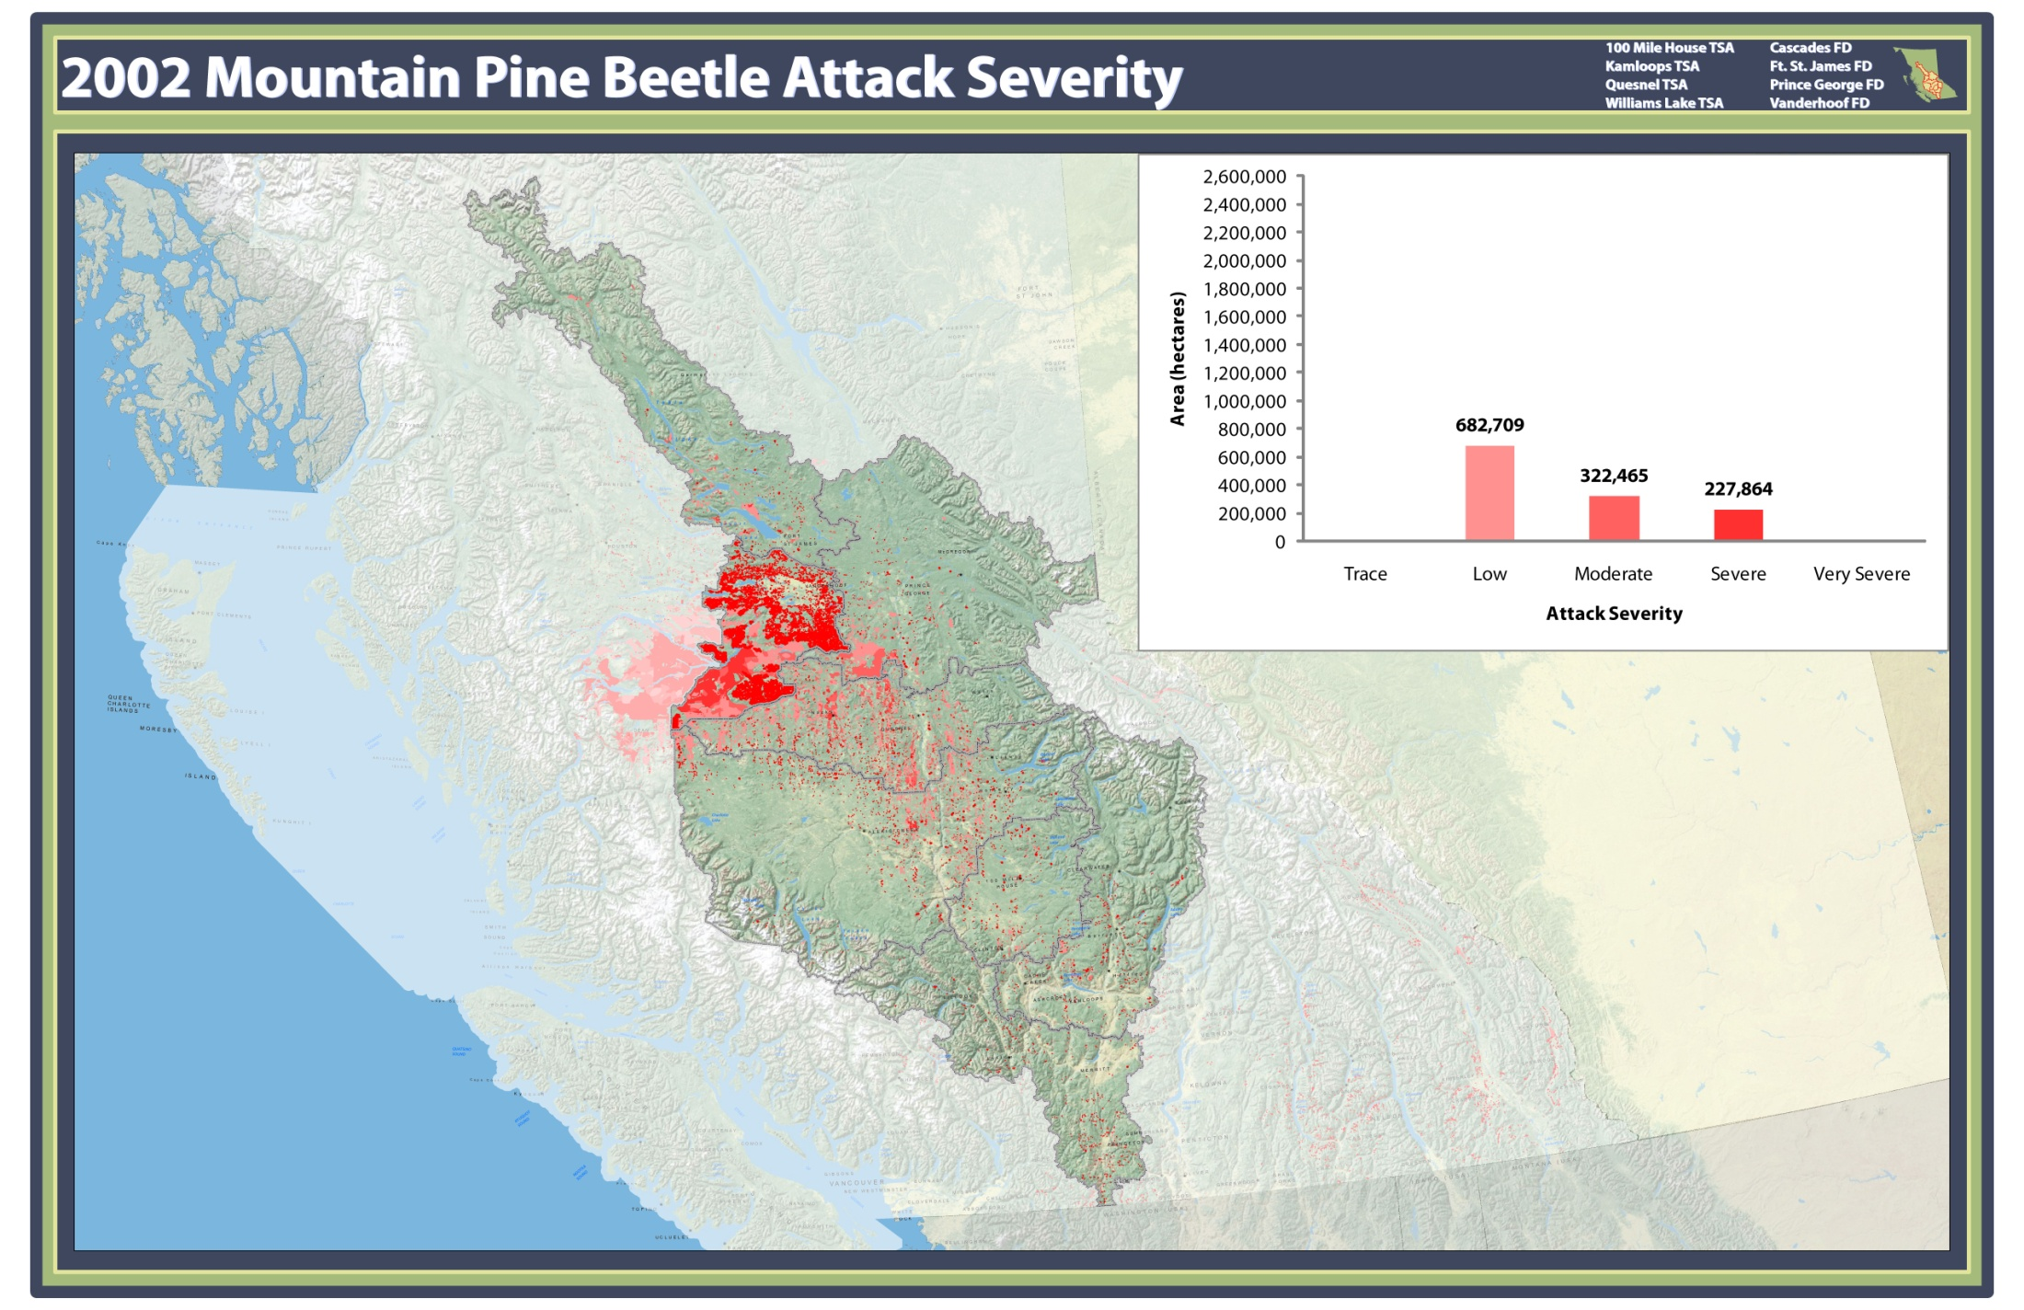

Slide 6
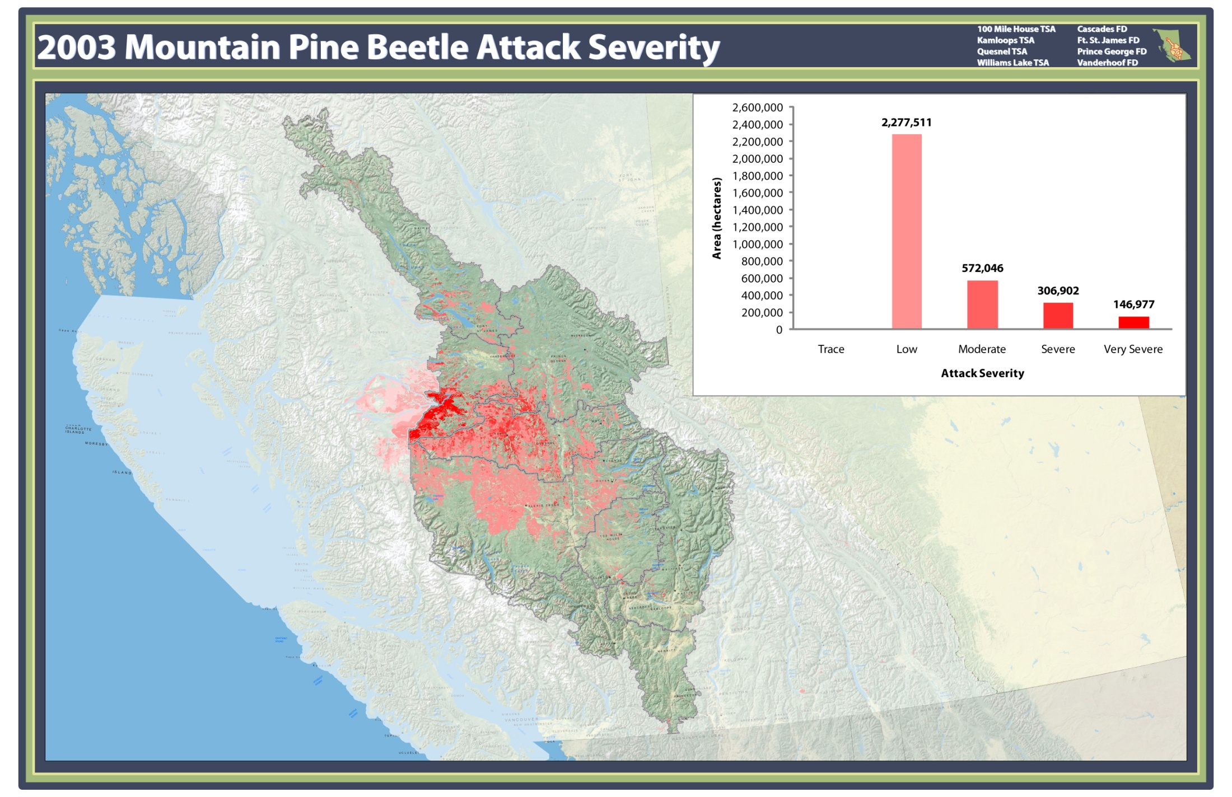

Slide 7
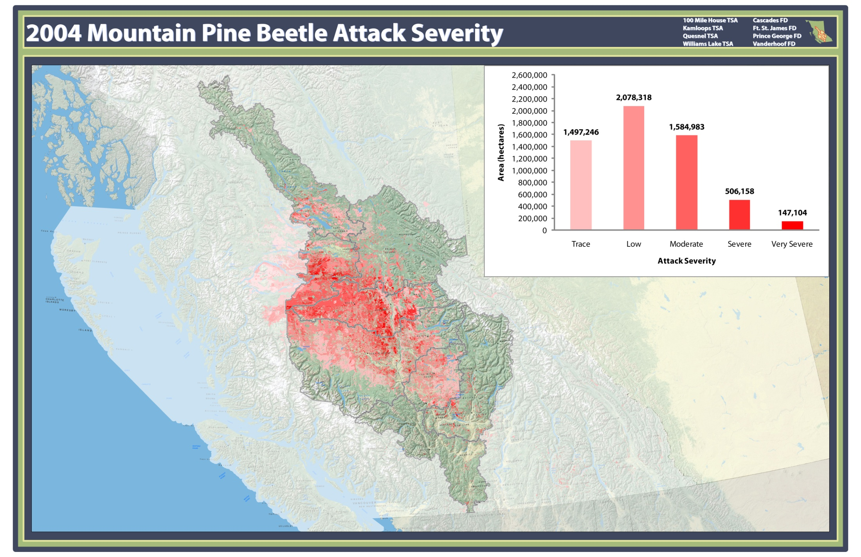

Slide 8
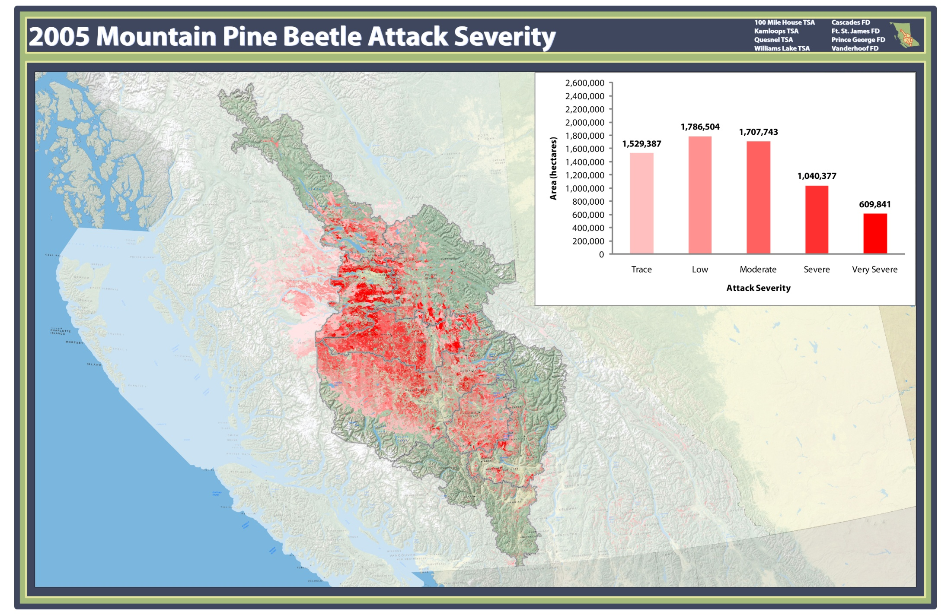

Slide 9
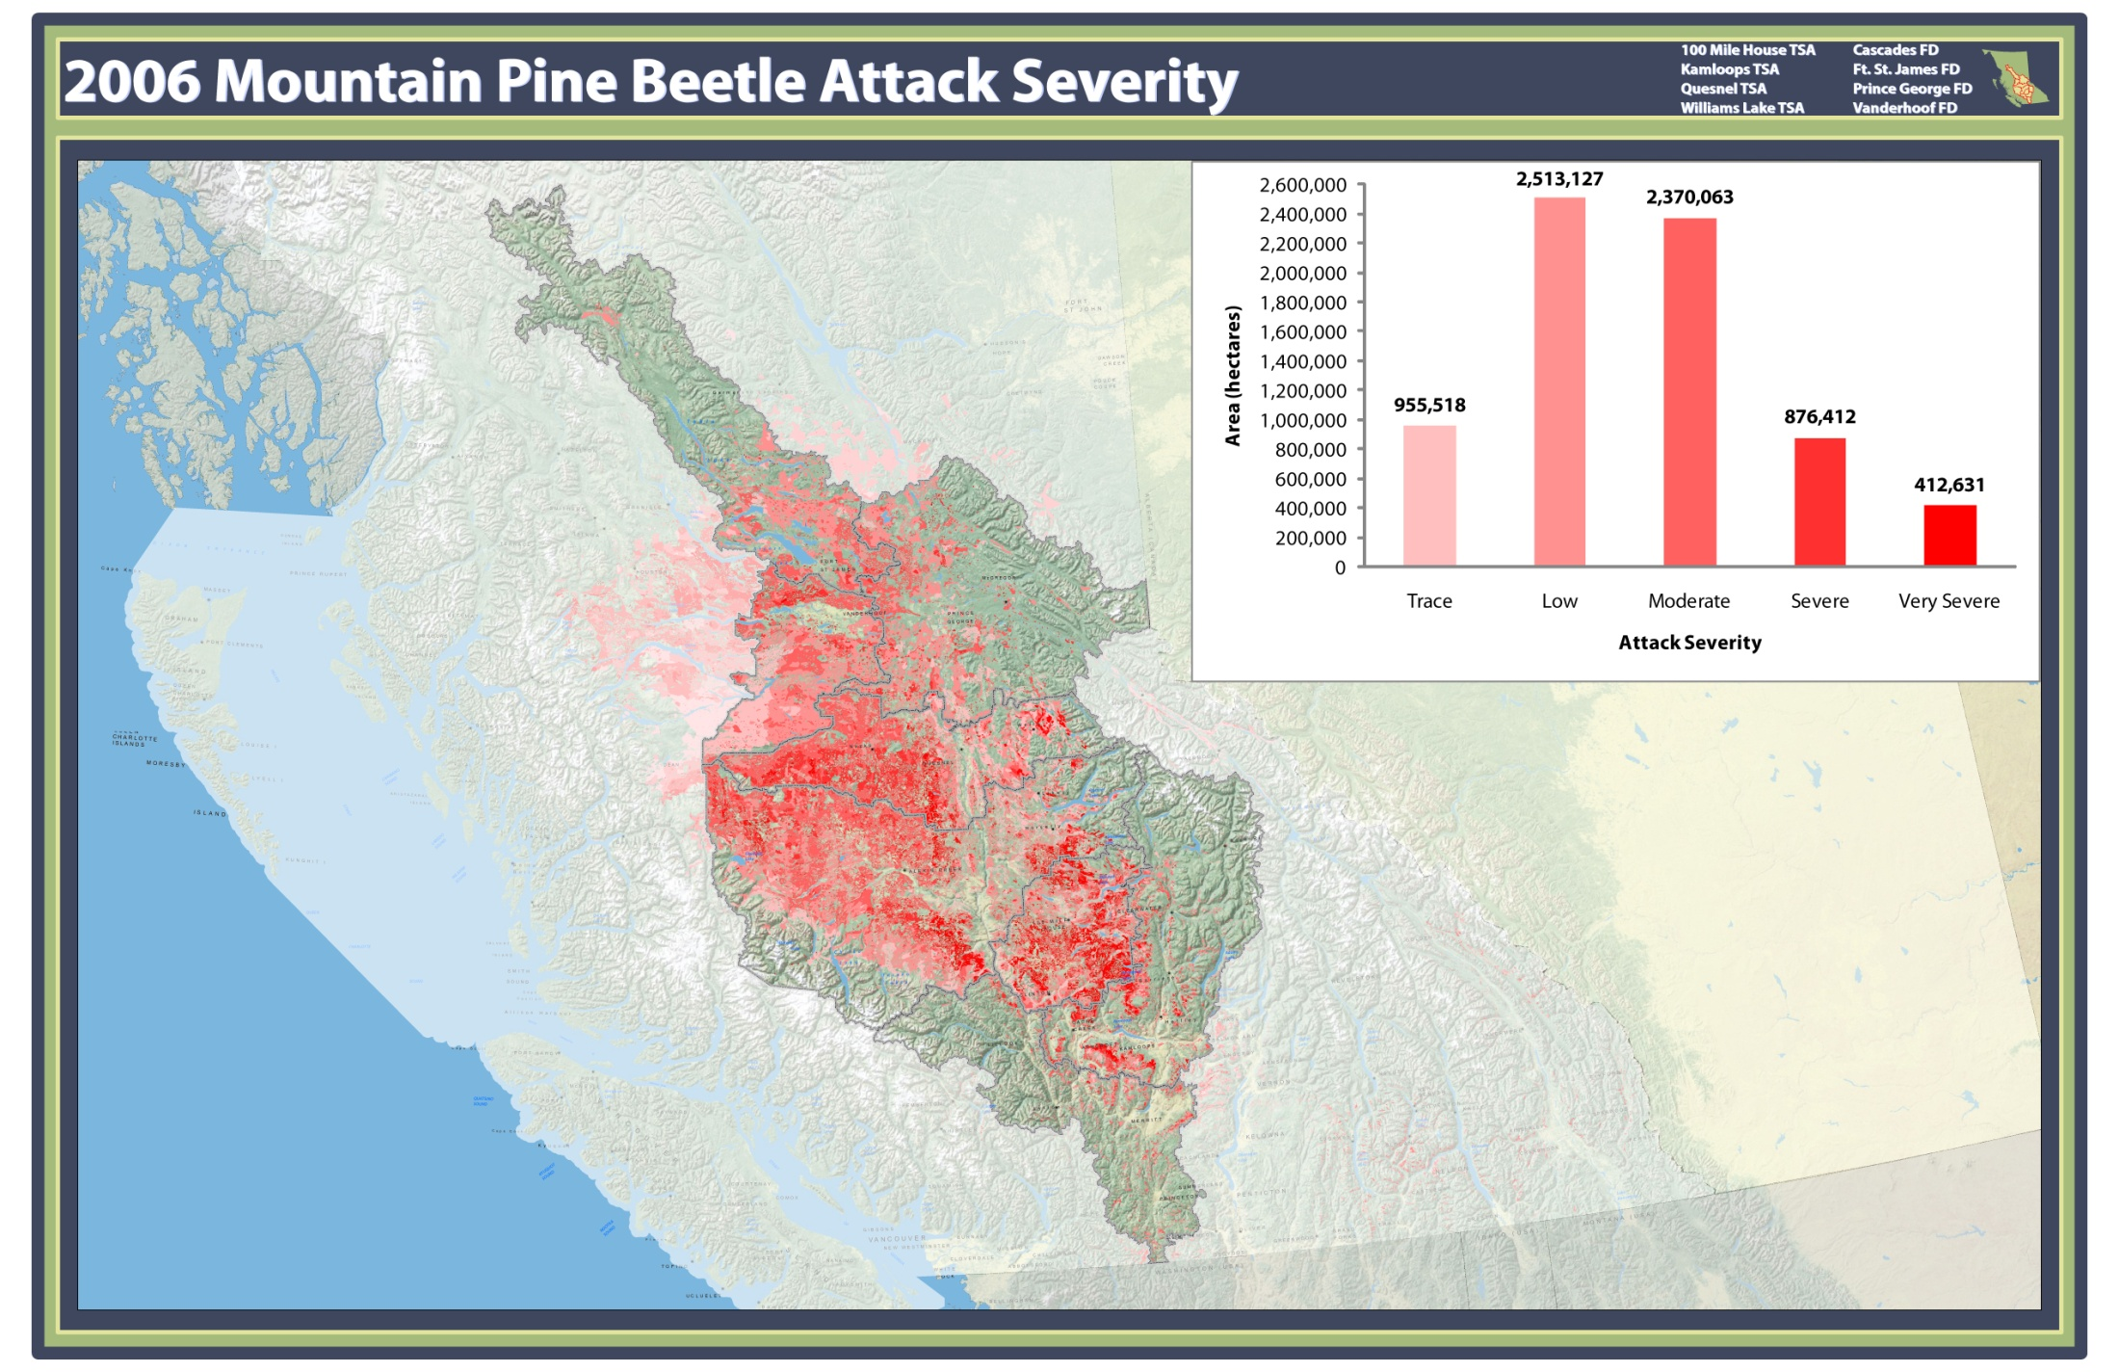

Slide 10


Slide 11
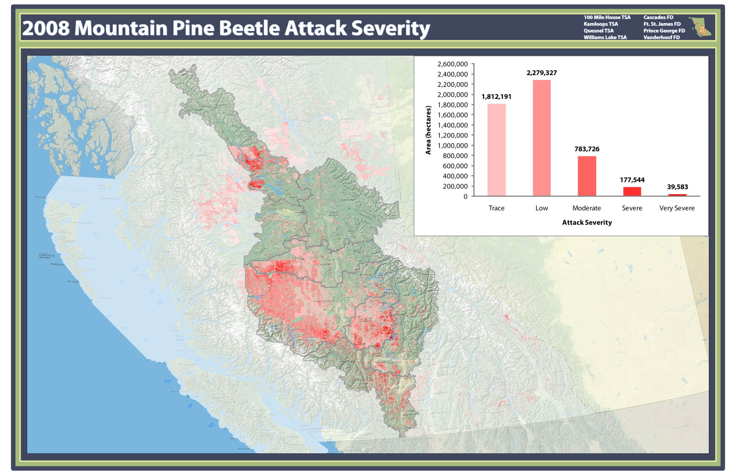

Slide 12
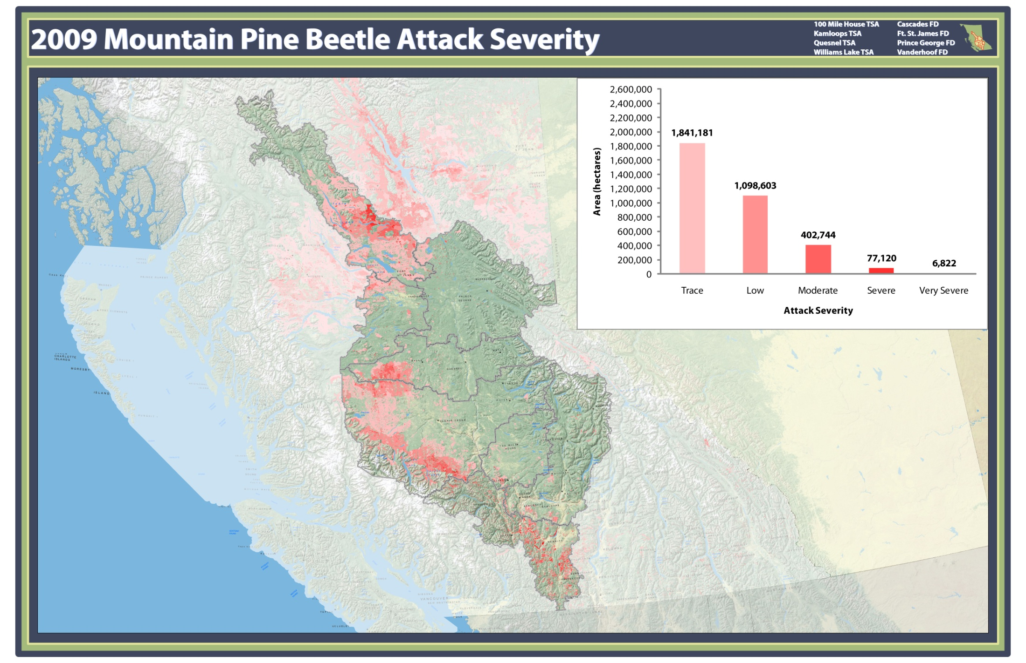

Slide 13


